Slide 1
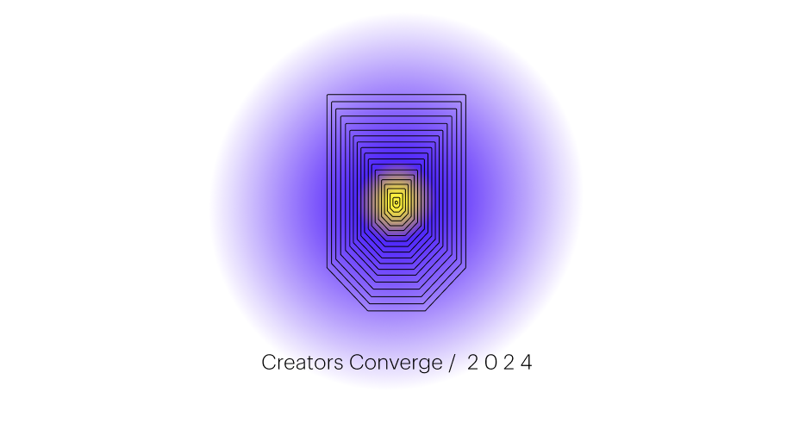
AI Generated Data Model with JSON Schema
Innovation Week 2024

Slide 2
Team Introduction
Carey Boldenow (Captain) – Engineer Principal (Omnichannel Engineering)
Sirivalli Penmetsa – Software Engineer II (DAT Employee Content team)
Oleg Zhylin – Health Engineer Senior (Lively Mobile 2/R5 team with Best Buy Health)
Alpesh Doshi – Senior Engineer (Digital Tooling Xperience team)
Tomin Thomas – Associate Engineer (Repair Workbench Fulfillment team)

Slide 3
Project Overview
Problem Statement:
During a customer support call, Best Buy Call Center (BBCC) agents are required to capture key aspects of the call, including the reason for the call, the action the agent took to resolve the customers need, and other information. These details are used for reporting and to improve service.
This effort is manual, potentially error prone, and relies heavily on agent training and experience.
Solution:
Create a team of AI agents that can summarize the call, extract key details from the call transcripts, do follow up with either a human agent or an API to get missing details, persist output, and generate reports.
The details to be extracted and what details are required can be provided to the AI agents from a JSON schema that is managed by the business.
This does not need to be a one size fits all schema, it can dynamically change based on the characteristics of the agent/customer interaction.

Slide 4









High-level Architecture
Why multi-agent?
LLMs perform much better when larger tasks are broken down into smaller tasks.
Each agent can pick the right tools for the job (e.g. any model, AI framework, etc).
Group Chat Manager - orchestrates all the activity by exchanging messages with each of the agents. It leverages gpt4-turbo to help manage all the conversations.
User Proxy Agent – converses with human when necessary.
Functions Executor Agent – runs python functions on behalf of other agents.
Entities Extractor Agent – this agent works with gpt4-turbo to prepare the function that will extract all the entities from the call transcript using langchain and the JSON schema.
Engineering Agent – this agent works with gpt4-turbo to prepare the function that will validate the output from the Entities Extractor Agent to ensure that the output is valid per the JSON Schema. If there are required field values missing, this agent will work with the other agents to collect those values from the human and update the output accordingly.
Database Analyst Agent – this agent works with gpt4-turbo to prepare the function that will insert the final extracted entities output to the Postgres database.
Reporting Agent – this agent works with gpt4-turbo to generate a markdown report that represents the final extracted entities output.
Microsoft AutoGen
multi-AI agent conversation framework
(open-source python package)
Group Chat
Manager
User Proxy
Agent
Functions Executor Agent
Entities Extractor
Agent
Engineering
Agent
Database Analyst
Agent
Reporting
Agent
converse
JSON Schema
run code
extract entities
validate extract
transcript summary
generate report
Python
LangChain

Slide 5
Demo
Live Demo…

Slide 6
Thank you.

